Slide 1
Amazon Reviews Analysis
By Suhail Sharafuddin

Slide 2

Context
Many companies are using sentiment analysis
Developing customer loyalty and figuring out why people might prefer competitors’ products
Notes:
Sentiment analysis- approach to nlp that identifies emotion for body of text
Helpful to classify reviews as positive, negative, or neutral, which allows them to undersyand customer satisfaction levels and improvement

Slide 3
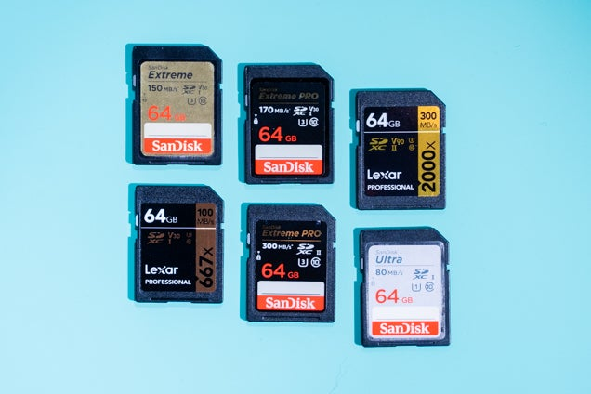
The Problem Statement
Using Amazon reviews, see if I can predict sentiment
Amazon reviews of SanDisk SD cards
Notes:
In this project, I will use models to guess the sentiment of the reviews using sentiment analysis. The models will guess whether the given review is positive, negative, or neutral, and give it a score as well.

Slide 4
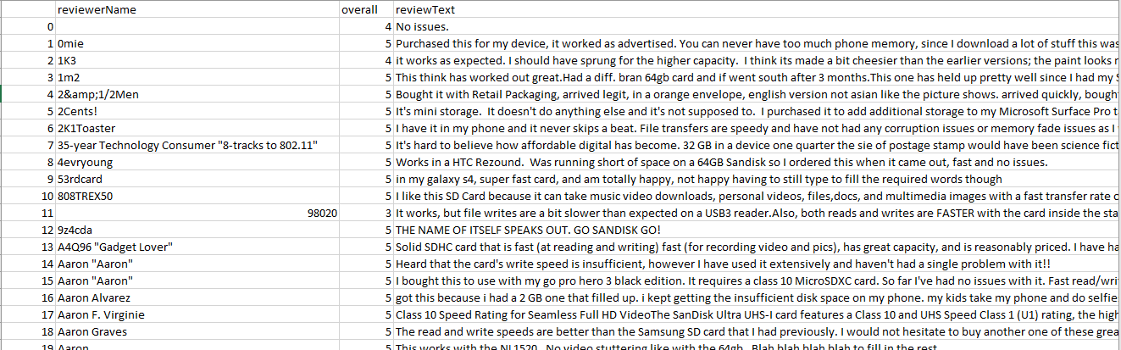
Data
Almost 5000 rows of data
Other columns: user id, how many people found the review helpful, and star rating

Slide 5

Data Wrangling
Data mostly clean
Two NAN values: reviewText and reviewerName
Deleted reviewText and kept reviewerName

Slide 6


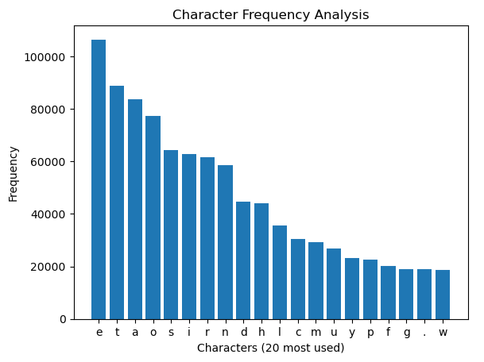
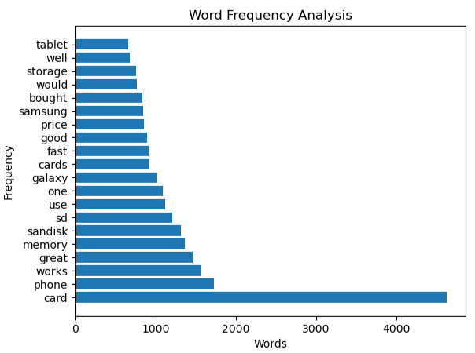



Exploratory Data Analysis
Notes:
I plotted the 20 most used characters in the string. If I plotted all characters, then the graph would become too muddled. I also took out the spaces, as spaces were by far the most used character. As shown below, 'e','t','a', and 'o' were the most frequent characters.
Next, I looked at the frequency of the 20 most used words. 'card' was much higher than any word, with 'phone','works','great', and 'memory' being incredibly frequent as well. This was when I realized that the overall sentiment would most likely be positive.

Slide 7
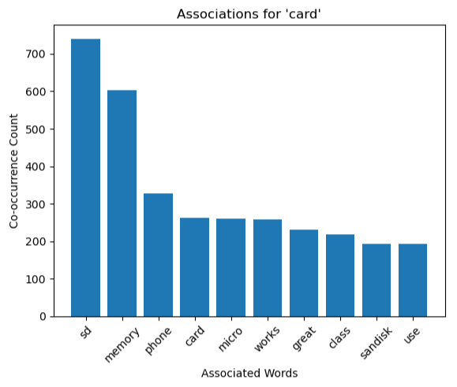
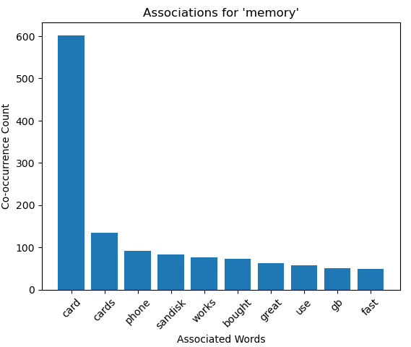
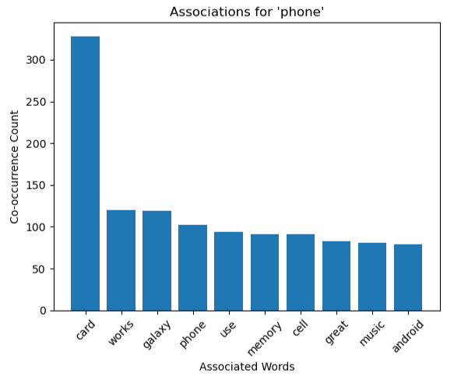
Exploratory Data Analysis
Notes:
Most of the associations were more technical such as 'card','phone','memory', and 'sd'. However, in terms of association when it relates to sentiment, it seemed positive. This was because they were heavily associated with 'great', 'fast', and 'works'.

Slide 8
Model Selection
Model_1:
based on the DistilBERT architecture
LABEL_1 = positive, LABEL_0 = negative
Model_3:
fine-tuned on English language product reviews by Julie Simon
LABEL_1 = positive, LABEL_0 = negative
Model_2:
fine-tuned on the Stanford Sentiment Treebank (SST-2) dataset
Almost 12,000 sentences from movie reviews
Notes:
Bidirectional Encoder Representations from Transformer-family of models from google in 2018, Toronto bookcorpus and Wikipedia, even chatgpt uses it

Slide 9


Review 1
Model_1:
Model_2:
Model_3:
Notes:
model_1 is more neutral with its score. model_2 has an incredibly high negative score, even though the review was nowhere near that negative. model_3 has an incredibly high positive score, even though the review was not that positive. However, I would say that the review is more positive than negative.

Slide 10


Review 2
Model_1:
Model_2:
Model_3:
Notes:
model_1 is not able to be any higher than 55%, and that hurts it when looking at this review. model_2 is correct and model_3 are correct. It is interesting that model_3 has a higher score than model_2, as that is usually not the case. However, this review is quite positive, so it makes sense.

Slide 11
Review 3
Model_1:
Model_2:
Model_3:
Notes:
model_1 has the sentiment correct, but cannot handle extremes(very positive or very negative reviews). model_2 is incorrect about the sentiment for this review. It rarely seems to capture reviews that are more neutral. model_3 is correct about the sentiment and the score. It generally seems to handle extreme reviews better than model_1 and neutral reviews better than model_2.

Slide 12
My Positive Review
Model_1:
Model_2:
Model_3:

Slide 13
My Negative Review
Model_1:
Model_2:
Model_3:

Slide 14
My Neutral Review
Model_1:
Model_2:
Model_3:

Slide 15
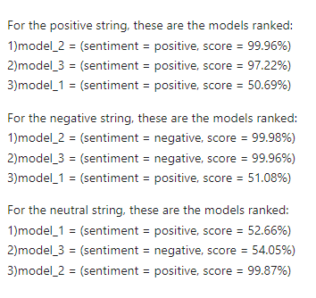
Takeaways
Notes:
So, my earlier assumptions about the three models were correct. This was:
model_1 can handle neutral reviews well, but not extremely positive or extremely negative reviews well.
model_2 can handle extremely negative and extremely positive reviews well, but not neutral reviews well.
model_3 can handle extremely positive, extremely negative, and neutral reviews well.
Ultimately, model 3 was the best model for sentiment analysis on these reviews. It was the only model that could handle the extremes, and the more neutral reviews.

Slide 16

Future Research
Rewarding working with NLP
My own NLP models and other pretrained models
Masked Language Modeling

Slide 17
Questions?

